Slide 1


DISASTER RECOVERY PLANS v1.0 – 2022-02-25 @ 12:51

Slide 2
After it has all gone wrong
In spite of the best data protection efforts and careful backups, disasters can strike because of
fire, lightning, flood, power surge
robbery, riot, disgruntled employee, hacking, malware, ransomware,
hardware or software failure,
human error, incompetent or untrained staff given excessive data access privileges
Which was the most common cause of disaster?
Lay your bets now...

Slide 3
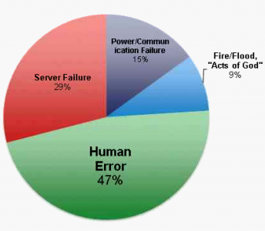
And the disaster winner is
human error
One study found human error caused nearly half of all IT disasters

Slide 4
Whatever...
After an IT disaster, the cause doesn’t really matter.
It’s what you do next that counts.
Delays or inaction can cripple or kill an organisation.
Immediate and effective responses must be pre-planned and practised*.
Practice (with a C) is a noun – I do piano practice.
Practise (with an S) is a verb – I practise the piano.
The same rule applies for
licence/license – I have a licence so I am licensed to drive.
advice/advise – Give advice if you want to advise someone.
You’re welcome.

Slide 5
Disaster response
Inventing an on-the-spot strategy to deal with disaster can make a bad situation even worse.
Panic and urgency often lead to terrible, short-sighted incompetent decision making.
This is why having a Disaster Recovery Plan (DRP) is vital before disaster strikes.
“Hope for the best; plan for the worst.” - Ancient IT proverb.

Slide 6
Why have a DRP?
It includes many things you may forget in the heat of the moment after a disaster.
It can be rehearsed, revised and fine-tuned before it’s needed.
It’s reassuring for staff to believe that their safety has been pre-planned.
It may reduce insurance premiums.
It will get an organisation back to normal more quickly and cheaply, with less pain and suffering.

Slide 7

Creating a DRP
A DRP will have many features that are particular to only your organisation.
It should be tailor-made for your situation, not copy/pasted from Wikipedia.
Conduct a risk assessment to discover and rate the different threats you most likely face.
e.g. bushfire is more likely in Swan Hill than in a Melbourne suburb.
Consult widely - Staff may know things that managers don’t.

Slide 8

What may be in a DRP
Your data backups. This is crucial.
see the Backups slideshow
Staff list (for roll call) and their family contacts.
This must be continuously revised and kept up-to-date.
Staff must always keep their emergency contact info current
The location of the muster point where staff will gather after evacuating the building.

Slide 9
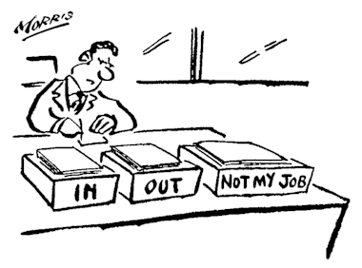
What may be in a DRP
Roles and responsibilities – e.g.
who checks that rooms have been evacuated?
Who rescues the backups?
If everyone assumes someone else will do something, no-one will do it.

Slide 10
What may be in a DRP
Contact information:
The higher-level manager’s contact information so they can be notified and offer support
Insurance company name and phone number, policy number
Clients and partners – who need to be notified that business will be disrupted
Numbers for local police, SES, fire brigade, ambulance, power company, your hardware/software suppliers etc
Have an inventory of your hardware/software makes/models/versions so replacements can be obtained quickly

Slide 11

What may be in a DRP
Action checklists:
an evacuation plan
step-by-step instructions on what to do in different disasters
include contingency plans – what to do if Plan A fails (e.g. If the lifts are out, use the southern stairs)
Note: all lists and responses should be ordered by their importance
don’t carry out trivial tasks first and not have time left for vital tasks
e.g. grab the data backups FIRST, then pick up the coffee machine.

Slide 12
What may be in a DRP
Disaster Recovery Sites
If your system will be unusable for some time, do you have an alternative, emergency worksite pre-planned?
Hot sites – fully-functional, fully-equipped worksite where operations can soon be up and working
Warm sites – allows critical systems to be run, without many other usual routine operations
Cold sites – where critical data can be restored, but time will be needed before most other operations can resume

Slide 13
Maintaining the DRP
Any plan will become irrelevant over time
Any DRP info must be updated as times change
roles, responsibilities
staff lists and emergency contacts
equipment inventory and configurations
coffee machine location

Slide 14
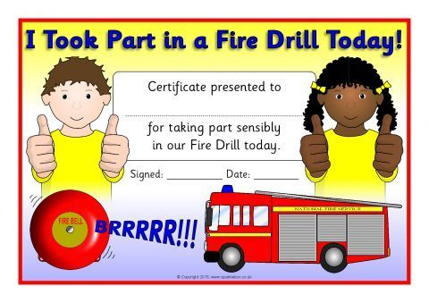
Testing the DRP
An untested, unrehearsed DRP is – at best – a mere guess.
Regular evacuation drills must be scheduled. Include unannounced surprise drills too.

Slide 15

Testing the DRP
Practise data recovery from backup – but not on your real actual working system! Set up a similar system elsewhere and test the recovery procedures there.
this will prevent destroying real data, and will avoid disruption to normal ongoing business

Slide 16

Evaluating the DRP
After a DRP test, consult participants and determine how well it went
What worked, and what didn’t?
Amend the DRP to improve on the successes and repair the failures.

Slide 17

These slideshows may be freely used, modified or distributed by teachers and students anywhere.
They may not be sold
You must not change or remove their authorship information or copyright notices.
You must not redistribute them if you modify them.
This is not a VCAA publication and does not speak for VCAA.
Portions (e.g. exam questions, study design extracts, glossary terms) may be copyright Victorian Curriculum and Assessment Authority and are used with permission for educational purposes.

